Slide 1






This is my
Hospital Passport
Photo
My name is:
I understand that this passport is designed to help hospital staff care for me by giving them information about my needs. Please hang this passport on the end of my bed.
More detailed information can be found in my care plan.
Nursing and medical staff please look at my passport before you do any interventions with me.
Things you must know about me
Things that are important to me
My likes and dislikes

Slide 2








Things you must know about me
Name:
I like to be called:
NHS number:
Date of birth:
Address:
Telephone number:
If you need to contact someone who knows me really well, please contact my main carer.
Name of main carer:
Relationship to me:
Telephone number:
Religion:
Ethnicity:
Normal weight:
GP name and phone number:

Slide 3



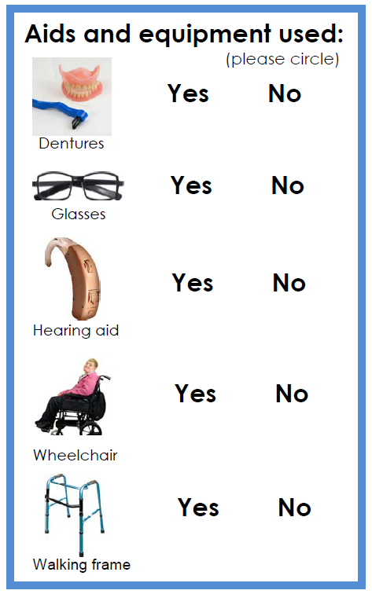
Things you must know about me
How I communicate:
What language I speak:
Allergies:
Medication:
How I take medication (crushed tablets, injections, syrup):
Known medical conditions:
Aids and equipment I use:
(please circle)
YES NO YES NO YES NO YES NO YES NO

Slide 4

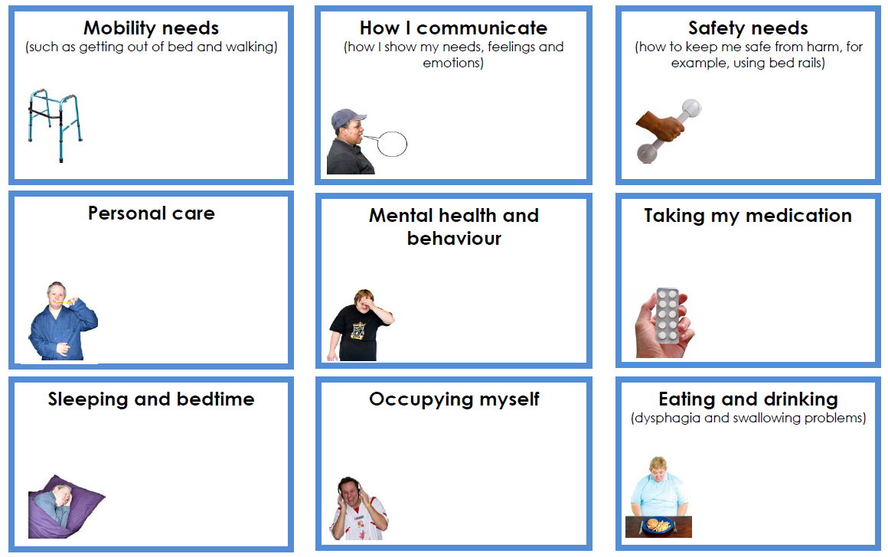
Things that are important to me
Mobility needs:
(such as getting out of bed and walking)
How I communicate:
(how I show my needs, feelings and emotions)
Safety needs:
(how to keep me safe from harm, for example, using bed rails)
Mental health and behaviour:

Slide 5
Things that are important to me
Personal care:
Taking my medication:
Sleeping and bedtime:
Occupying myself:
Eating and drinking:
(dysphagia and swallowing problems)

Slide 6



My likes and dislikes
Likes: what makes me happy, things I like to do – for example, watching TV, reading, music.
Dislikes: for example – don’t shout, food I don’t like, physical touch.
Things I like:
Things I dislike:

Slide 7

Contacts and useful websites
Guy’s and St Thomas’s Acute Team
Email address: X
Telephone number: X
Guy’s and St Thomas’s Community Team
Email address: X
Telephone number: X
King’s College Hospital
Email address: X
Telephone number: X
South London & Maudsley MHLD
Email address: X
Telephone number: X
https://learningdisability.co.uk/
https://www.learningdisabilityengland.org.uk/
www.mencap.org.uk/gettingitright
Please contact your local community learning disability team
if you have any questions about the passport.
Please ask me for my Covid-19 Grab and Go Guide Form. A template can also be found here.

